Slide 1

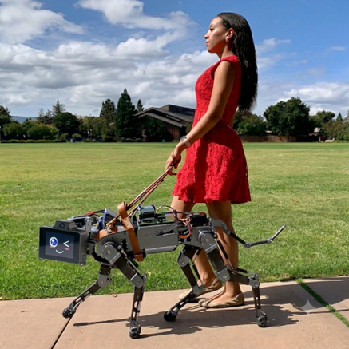
Intelligent Navigation-Assistant Dog for the Visually Impaired People Based On Pretrained AI Models
Nathan Beer and Tomer Bengayev
Instructor: Idan Tobis and Dr. Yakov Damatov
Course: Human-Robotic Interaction

Slide 2
Introduction:
Rationale & Motivation:
The initial phase of this Human-Robot Interaction (HRI) project involved exploring how robotics could best address various accessibility needs; ultimately, the scope was narrowed down to focus specifically on developing a solution for visually impaired individuals.
Information of the problems with owning guide dogs was gathered from AFB (American Foundation for the Blind), a research that included three types of participants: current guide-dog users, former guide-dog users, and guide-dog nonusers.
In the survey the nonusers were asked why they choose not to use a guide dog for help, and the researchers were given the answer that dogs are too expansive, trained guide dogs cost around 30K to 60K dollars, and they don’t see themselves capable of taking care of a dog nor wanted the burden to have that responsibility, they also don’t see how dogs could help with competing life demands.
Another problem that came up in the survey was that when a guide dog parishes or retires and the owner gets themselves a new guide dog it takes them time to get used to the new dog, they often feel sad and guilty for the death of the previous dog which may impact the bonding with the new one.
We can conclude from this research that while dogs can be helpful to guide blind people, there are still some problems that cannot be ignored when owning a living guide dog, and therefore this project’s goal is to mitigate these issues, and even improve the capabilities of the human’s best friend.

Slide 3
Benefits of Using Robot Guide Dog:
The solution for the problems that arise from owning a guide dog is to own a robot guide dog that can do numerous things that a regular dog can’t:
First and foremost, one benefit of owning a robotic dog that solves a problem mentioned in the research is that a robotic dog cannot die nor retire, the owner will not have to get to the point where they need to leave the dog because they never will, the robot guide dog could serve them as long as help is needed, and not only that, a robot guide dog eliminates many of the care requirements associated with living guide animals, potentially increasing availability and reducing long-term maintenance demands, when need recharging its battery, the robot guide dog can do it on its own automatically. More than that a robot guide dog is intelligent and can talk to the user and listen to them in any language, it can read words and numbers, know how to navigate its owner from place to place using GPS.
Many universities were in the process of developing an intelligent guide dog that could replace a regular guide dog, for example a team researchers in Jiao Tong, University of Shanghaiin, that recognized a shortage in guide dogs in China decided to create robot guide dog. They developed a six-legged bulldog shaped robot that helps with navigating visually impaired people and tested it on a married couple that have difficulties in seeing, the robot had the ability to speak and listen in their language using artificial intelligence.
Professor Gao, the head of the research team, said that he can produce guide dogs like he can produce cars, and by doing so more visually impaired people will have that six-legged little helper, and the shortage of guide dogs will be reduced to zero, and also the price of these robotic dogs will be more affordable.

Slide 4
Goal:
The goal of this project is to develop a system interaction between human and a robot guide dog that could help visually impaired people navigate around the house*, help the user get to certain objects they wish to get to by communicating with the assistant dog and avoiding obstacles that might be in the way.
*Note: In this project we did not set outdoors navigation as an objective for the robotic guide dog
Tasks:
In order to achieve these goals there are three crucial tasks that need to be accomplished:
Voice-control: The robotic guide dog needs to be able to listen to human’s request and understand what they say.
Voice-feedback: The robotic guide dog needs to speak with the human, inform them of anything they need to know in the process of robotic guide dog’s navigation.
Navigation: The robotic guide dog needs to be able to navigate its user to the destination the user asks the robotic guide dog to get them to, robotic guide dog needs to be able to avoid obstacles that night appear in the way to the destination.

Slide 5
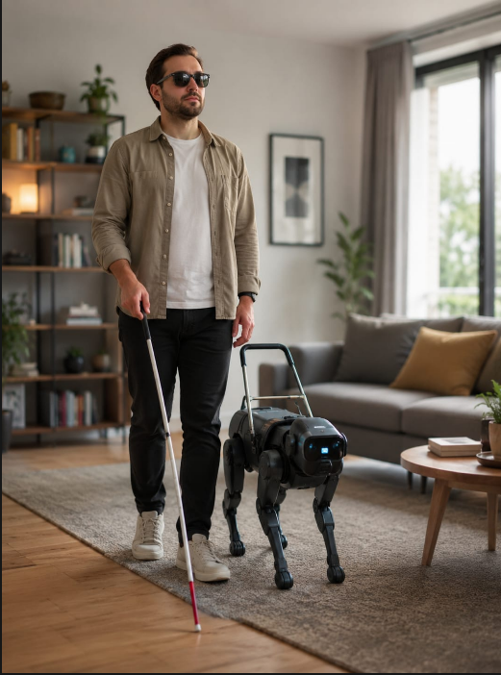
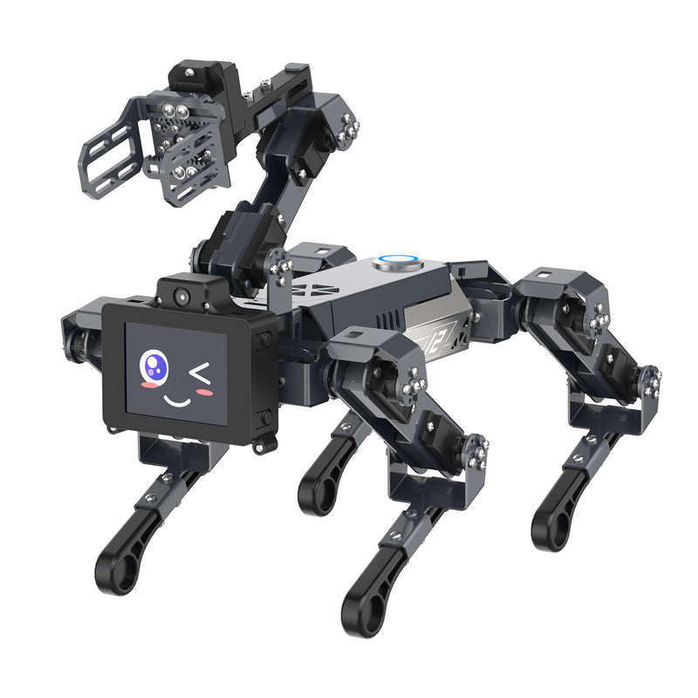
System Interaction performance
Turns on the robot
what would you like me to find?
Find [object]?
Understood we’ll go to [object]
When object is found
[object] was found, do you need anything else?
No
Shutting down
The interaction between human and robot guide dog works by communication, wirelessly.
The robot dog guide will ask user what they’d like to find, user says certain object, robot says it understood and is ready to go, when they reach the object, the robot guide dog will notify that they have arrived and ask whether there’s anything else the user would like it to find, if user says yes the process runs again, else the robot guide dog shuts down.

Slide 6
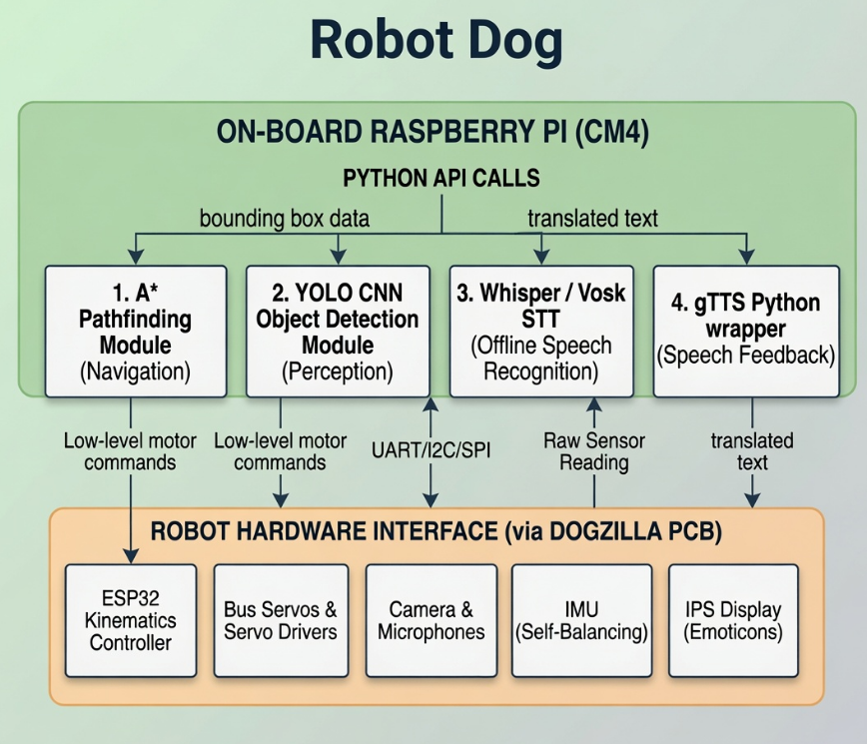
System Functional Block Diagram
Developer PC
Programming Language: Python
System Architecture Summary
The System Functional Block Diagram outlines the integration between high-level logic and physical hardware for the robotic guide dog.
1. Development Layer
Developer PC: Acts as the environment for coding, testing, and deploying Python-based algorithms.
2. Control Layer (Raspberry Pi CM4)
This "Brain" manages system logic via Python API Calls:
Navigation (A):* Determines optimal paths.
Perception (YOLO): Identifies environmental objects.
Input (Whisper/Vosk): Translates human speech to command text.
Output (gTTS): Synthesizes system status into audible speech.
3. Hardware Layer (DOGZILLA PCB)
This "Body" executes commands and gathers environmental data:
3.1 Movement: The ESP32 and Bus Servos drive physical locomotion.
Fig 2: Diagram of Dogzilla System System Functional Block Diagram
3.2 Sensing: The camera, microphone, and IMU provide real-time environment and balance data.
3.3 Visuals: The IPS Display provides non-verbal feedback via icons.
3.4 Operational Loop
The system functions through a continuous, closed-loop process:
Perception: Sensors feed raw data to the Raspberry Pi.
Analysis: Modules (YOLO, Whisper) process the input.
Control: A* plans movements; Python logic generates feedback.
Execution: The hardware interface translates instructions into physical movement and auditory output.

Slide 7
Platform Methodology:
A: Software
To achieve the stated objectives, the project will follow a structured methodology consisting of several key stages:
Programming Language: Python 3.12
Collect Software Requirements Models: Importing pretrained AI models that can help with the robot guide dog’s functionality:
YOLO: for vision recognition utilizing a deep convolutional neural network (CNN) for real-time target tracking.
Pathfinding: for navigation to calculate optimal, collision-free trajectory.
Whisper: for voice-control, utilizing a Transformer-based automatic speech recognition (ASR) architecture to convert speech to text.
gTTS: for voice-feedback, using neural speech synthesis API wrapper to convert system text into audible audio streams.

Slide 8
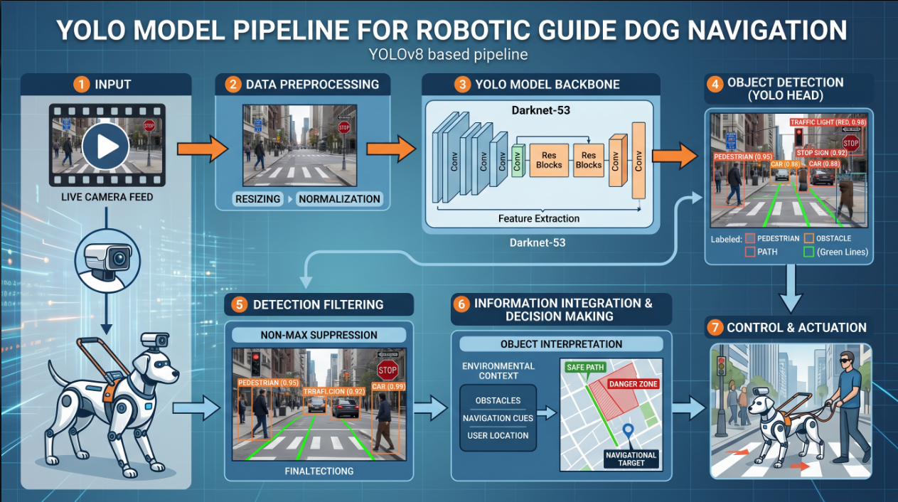
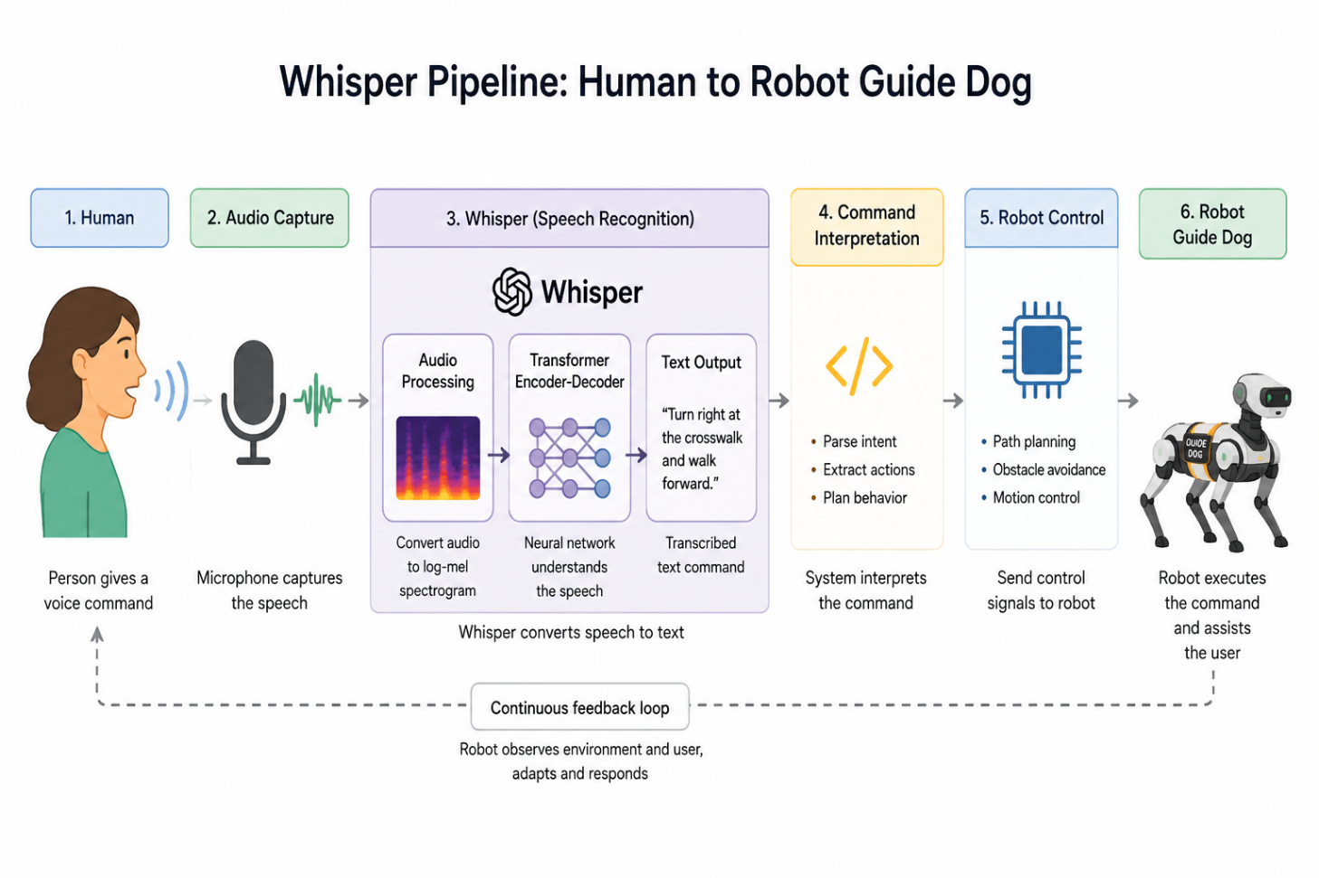
YOLO
Backbone (Feature Extraction): A deep CNN that strips raw pixels to isolate abstract features like edges, shapes, and textures.
Neck (Feature Fusion): Blends high-resolution spatial details with deep semantic concepts to detect both large objects and small hazards simultaneously.
Head (The Predictor): The final layers that output the mathematical tensors containing spatial coordinates and object labels.
Whisper:
Fig 3.1: Pipeline of YOLO model
1. Human (Voice Command): The user gives a natural spoken command to the system
2. Audio Capture: An onboard microphone captures the live speech waves and saves them into a raw audio buffer.
3. Text Output: The model outputs the final transcribed text command with minimal latency.
4. Command Interpretation: The system parses the transcribed text to identify the user's intent,
Fig 3.2: Pipeline of Whisper model

Slide 9
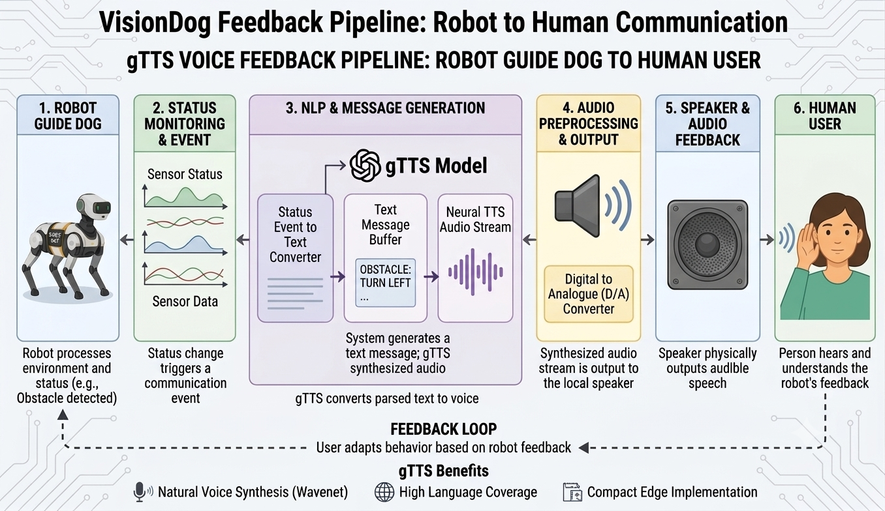
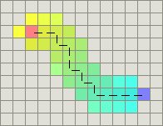
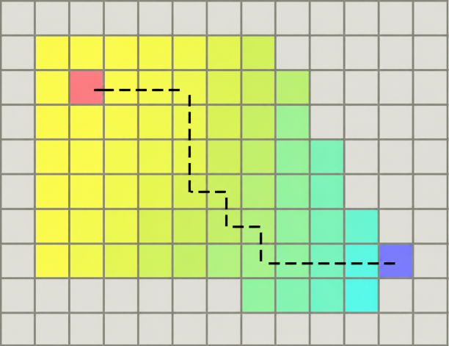
Library Softwares
gTTS:
gTTS (Google Text-to-Speech) acts as the robot's mouth, translating text strings into spoken
Text Generation & Normalization
Trigger: The robot's code detects an event (e.g., an obstacle) and creates a text string (e.g. "Obstacle detected. Turn left.")
Normalization: The gTTS library cleans the text, translating numbers, acronyms, and punctuation into fully pronounceable words.
Fig 4.2: Pipeline of gTTS model
Pathfinding (A* Navigation Algorithm)
Pathfinding is implemented using the A* algorithm, which identifies the optimal trajectory to a target while effectively navigating around obstacles. Although Dijkstra's algorithm also guarantees the shortest path, it requires an exhaustive search of all possible routes. In contrast, A* utilizes heuristics to guide the search, significantly reducing the computational overhead and increasing efficiency. Consequently, A* was selected for this application to ensure faster path calculation compared to Dijkstra's algorithm.
s
s
T
T
Fig 3.2: Visualization of A* algorithm in action from S to T
Fig 3.3: Visualization of Dijkstra algorithm in action from S to T

Slide 10
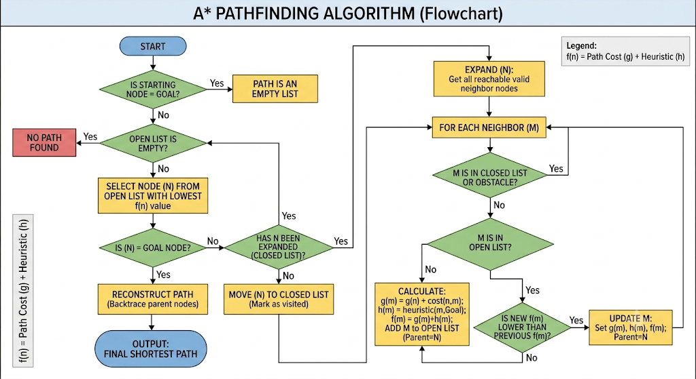
A* Navigation Algorithm:
The navigation component of this project utilizes the A* (A-star) algorithm from the Pathfinding library. A* is a widely adopted, optimal graph-traversal algorithm used extensively in fields such as GPS navigation, video games, autonomous space missions, and in many other fields.
Building upon the core mechanics of Dijkstra's algorithm, A* introduces a heuristic to significantly improve search efficiency. While evaluating a current node n to reach a target destination T, the algorithm calculates the total path cost for each neighbouring node n+1. The cost function, f(n), is the sum of the actual distance from the starting point to the neighbour, written as g(n), and the estimated distance from the neighbour to the target, written as h(n). A* then greedily selects the node with the lowest total expected cost.
Unlike Dijkstra's algorithm, which must perform a blind, exhaustive search by expanding all uniform directions, A* uses its heuristic to intelligently prioritize the search direction. This dramatically reduces the number of evaluated nodes while still guaranteeing an optimal shortest path.
Fig 6: Flowchart of A* algorithm

Slide 11
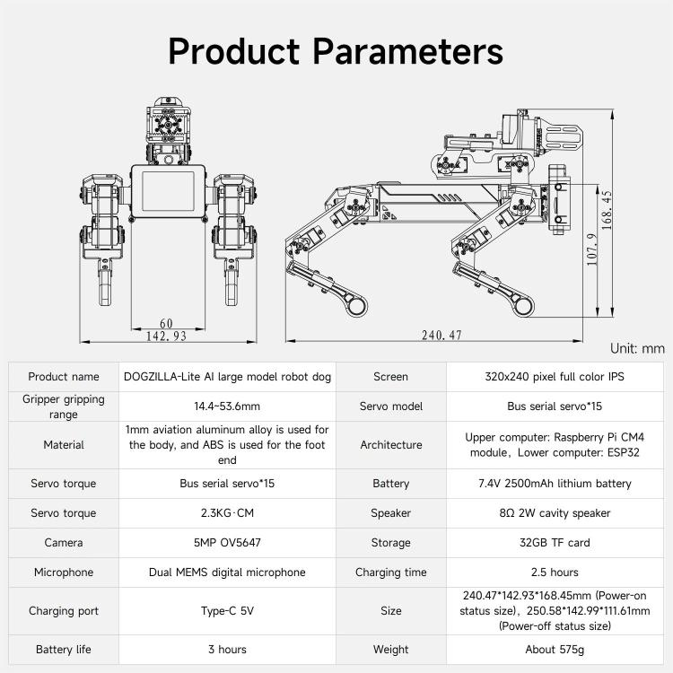
B: Hardware
For out experiment we chose to work on Dogzilla Lite type robot dog, it has many resources that help with its functionality so we didn’t have to build a robot from zero.
Degrees of Freedom: Dogzilla Lite has 15 Degrees of Freedom (DoF).
Processing & Architecture
Upper Computer: Raspberry Pi CM4 (handles high-level tasks like AI and navigation).
Lower Computer: ESP32 (manages real-time kinematics and motor control).
Storage: 32GB TF card.
Motion & Physical Build
Actuation: 15 bus serial servos, each providing 2.3 kg·cm of torque.
Dimensions: Approximately 240.47 x 142.93 x 168.45 mm.
Weight: ~575g.
Materials: Aviation aluminum alloy (body) and ABS (feet).
Sensing & Feedback
Visual: 5MP OV5647 camera.
Auditory: Dual MEMS digital microphones and an 8Ω 2W cavity speaker.
Display: 320x240 pixel full-color IPS screen.
Power
Battery: 7.4V 2500mAh lithium battery (3-hour life).
Charging: Type-C 5V port (2.5-hour charge time).
Fig 5: Dogzilla’s hardware resources

Slide 12
Summary
This project involved the development prototype of an intelligent robot guide dog designed to assist visually impaired users through an integrated system of perception, navigation, and feedback.
Technical Pipelines: Perception: A 5MP camera and YOLO CNN module identify objects, while Whisper translates spoken commands into text via the Raspberry Pi CM4.
Logic: The A* algorithm processes visual and command data to plan safe, optimal paths.
Interaction: The gTTS module provides audible navigation feedback, while the ESP32 handles real-time motor control for physical movement.
Discussion & Future Work
We successfully developed prototype a robotic guide dog capable of bidirectional voice interaction, real-time object detection, and autonomous path planning. The system effectively bridges the gap between high-level artificial intelligence and low-level hardware actuation, creating a functional prototype that interprets user voice commands and navigates toward target objects.
Throughout the development cycle, the system architecture was refined to address challenges in hardware-software integration and response latency. Through iterative debugging and code optimization, the team established a robust communication protocol between the onboard processing unit (Raspberry Pi CM4) and the robotic hardware interface (DOGZILLA PCB), resulting in a reliable, responsive platform.
To advance the system toward real-world applications, future iterations will prioritize:
Outdoor Navigation: Developing GPS-integrated, sensor-fused pathfinding to ensure user safety and precise guidance to specific destinations.
Intelligent Initialization: Implementing a "Voice-Wake" feature, where the robot autonomously locates the user upon command, initiates contact and prompts them for their destination.

Slide 13
Bibliography
Article of the robotic guide dog in Shanghai: https://www.abc.net.au/news/2024-07-02/robot-guide-dog-could-help-visually-impaired-people-daily-life/104047974
Article of the problems with guide dogs: https://afb.org/role-guide-dogs-joint-afb-gdb-report/why-not-use-guide-dog
Dogzilla Lite website: https://www.yahboom.net/study/DOGZILLA-Lite
A* algorithem explanation: https://www.datacamp.com/tutorial/a-star-algorithm

